Slide 1

Analysis of Healthcare and Congress
Joe Garcia

Slide 3
Research Question:
Is the age of congress increasing as time goes by?
Does healthcare in laws increase as congress age increases?
I think that yes, the age is increasing as time goes by, and that the healthcare laws or increasing.

Slide 4
Data
- From FiveThirtyEight, collected from Voteview.com and the U.S. House of Representatives. For my second Data set, I chose congress.gov, and scraped key elements from their search engine.
- https://voteview.com
-https://raw.githubusercontent.com/fivethirtyeight/data/master/congress-demographics/data_aging_ congress.csv
-https://www.congress.gov/quick-search/legislation?wordsPhrases=health+care&wordVariants=on&congressGroups%5B%5D=0&congresses%5B%5D=all&legislationNumbers=&legislativeAction=100&sponsor=on&representative=&senator=&q=%7B%22congress%22%3A93%7D

Slide 5
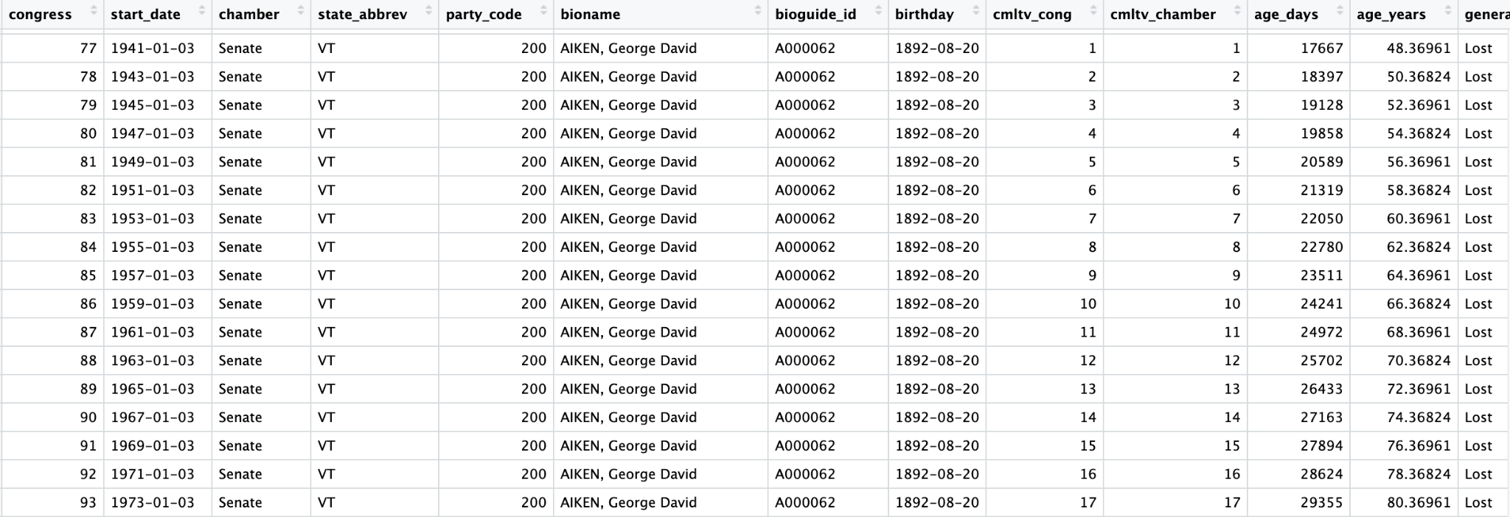
Data
The Fivethirtyeight data was very clean and tidy, we only used these 3 particular columns in our exploration.

Slide 6
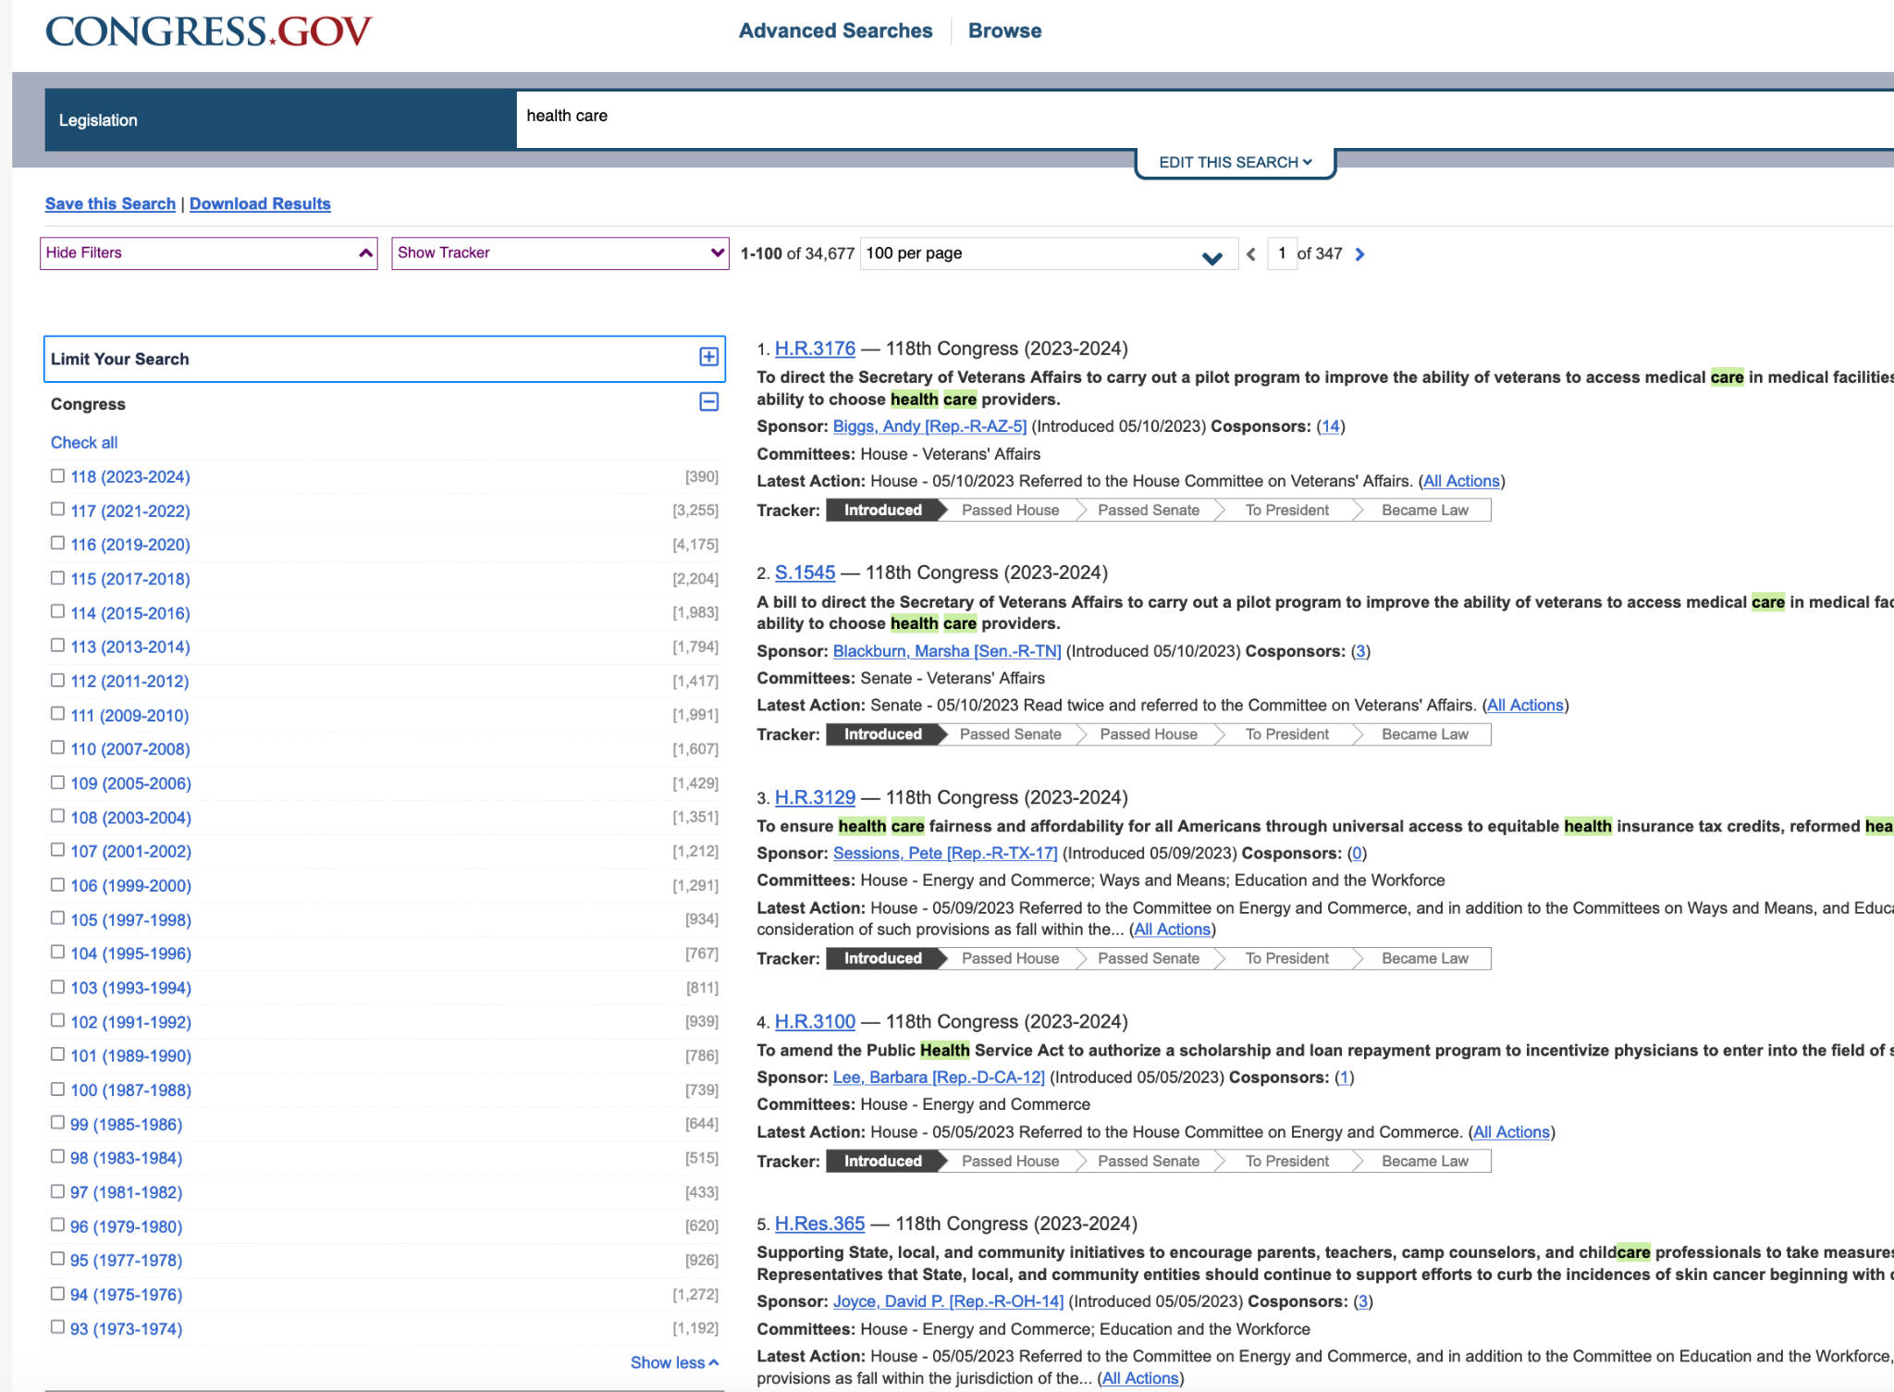
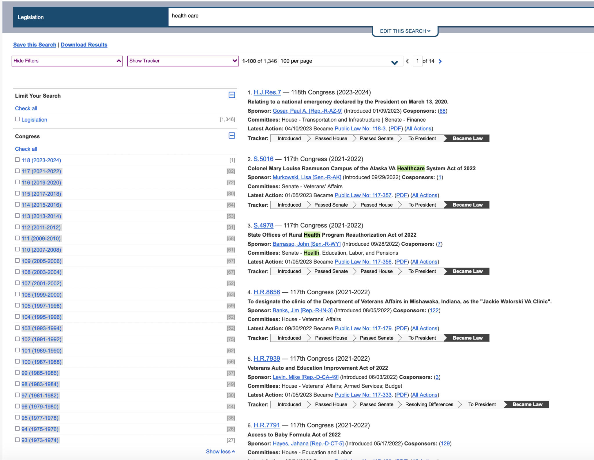
Data
Using the “health care” filter, we are given a robust data set. We have two subplots that we have extracted out of them the introduced laws and the became law.

Slide 7
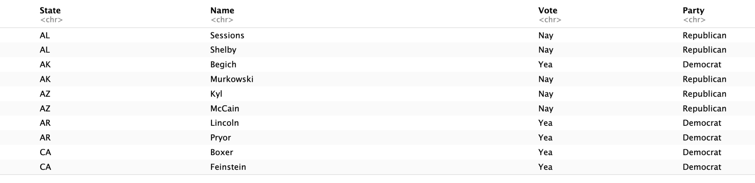
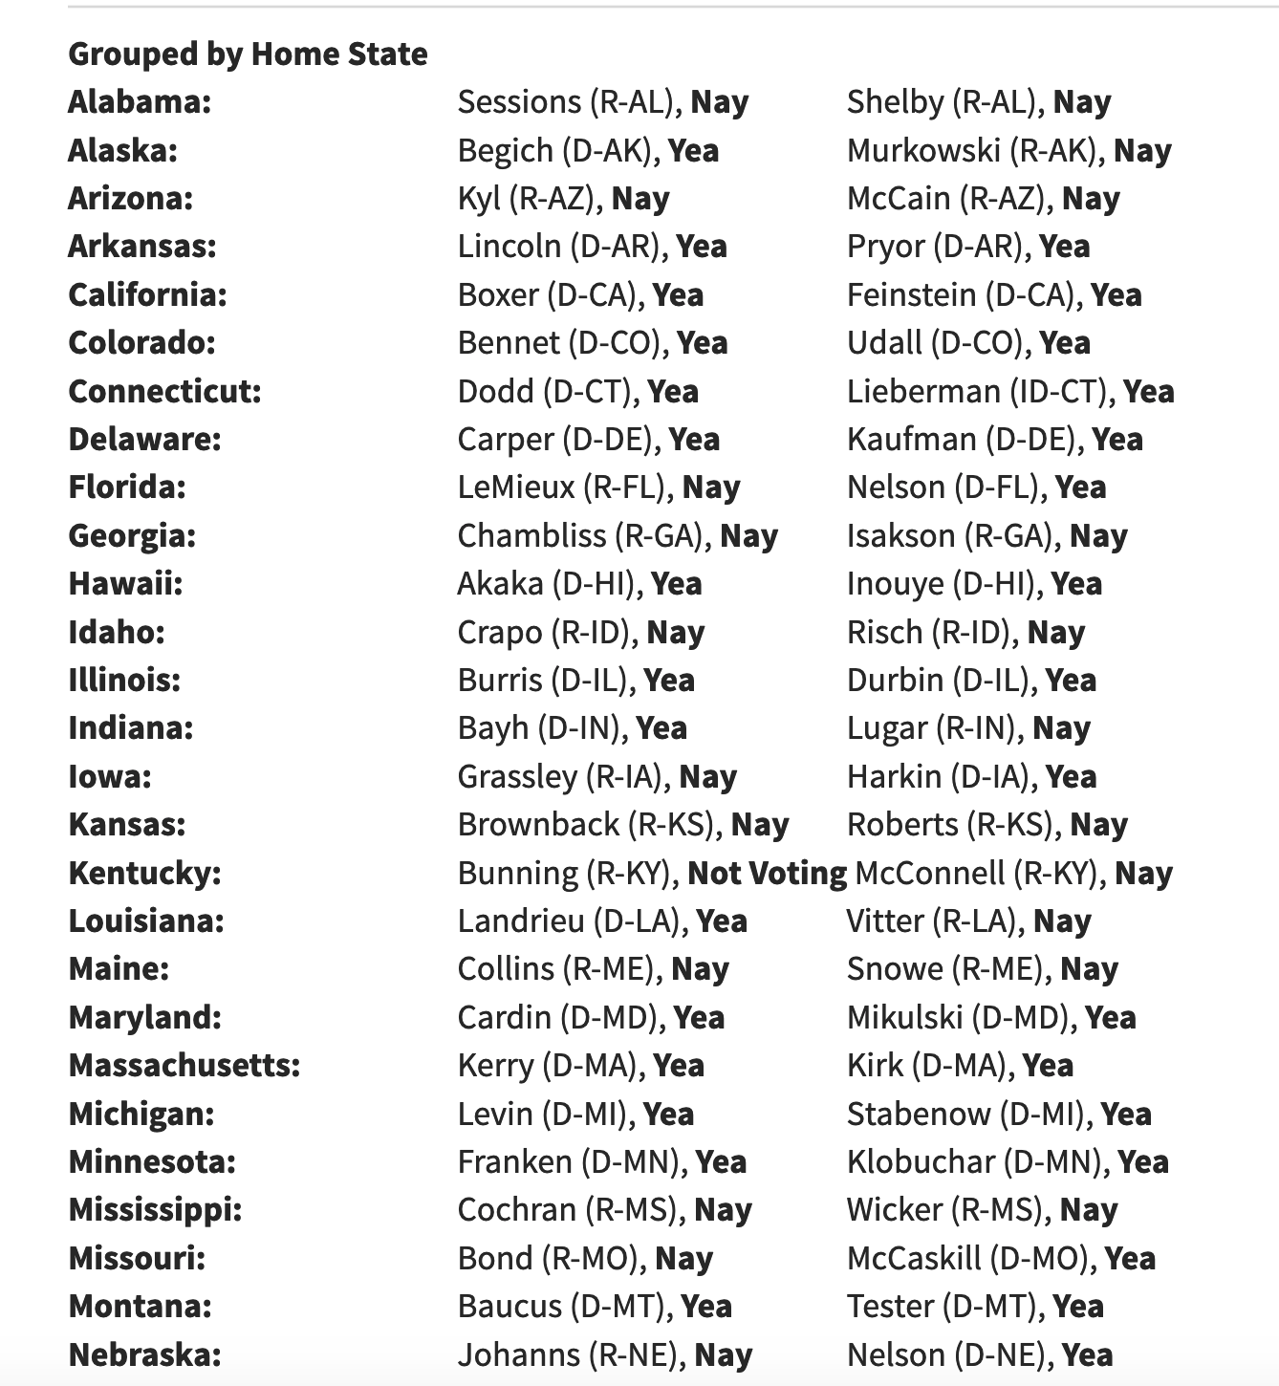
Case Study: ACA, Bill Number H.R. 3590
Data
Scrapped the data from the Affordable Cares Act voting record, cleaned and tidied the data.

Slide 8
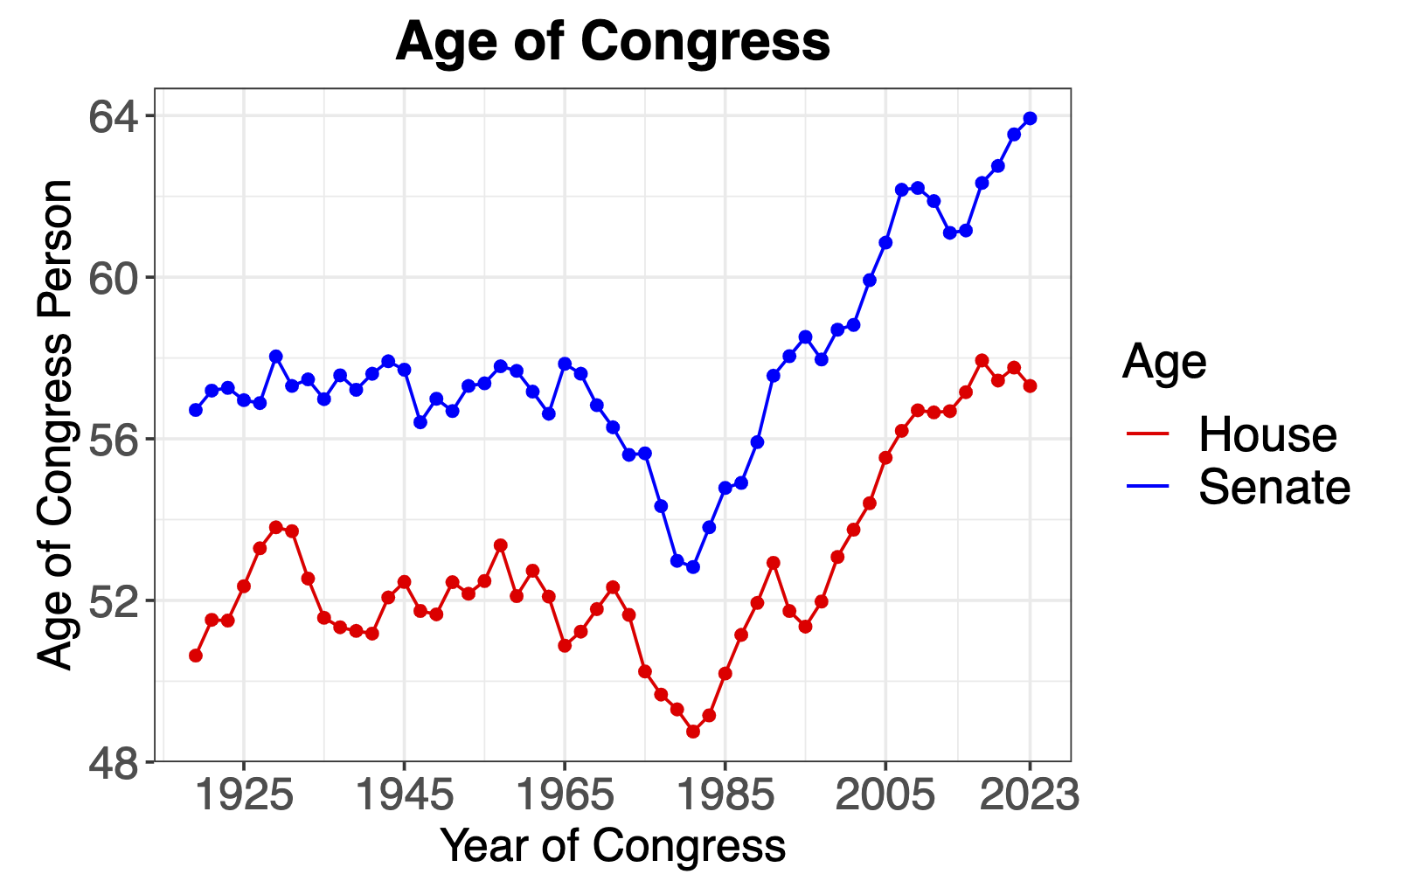
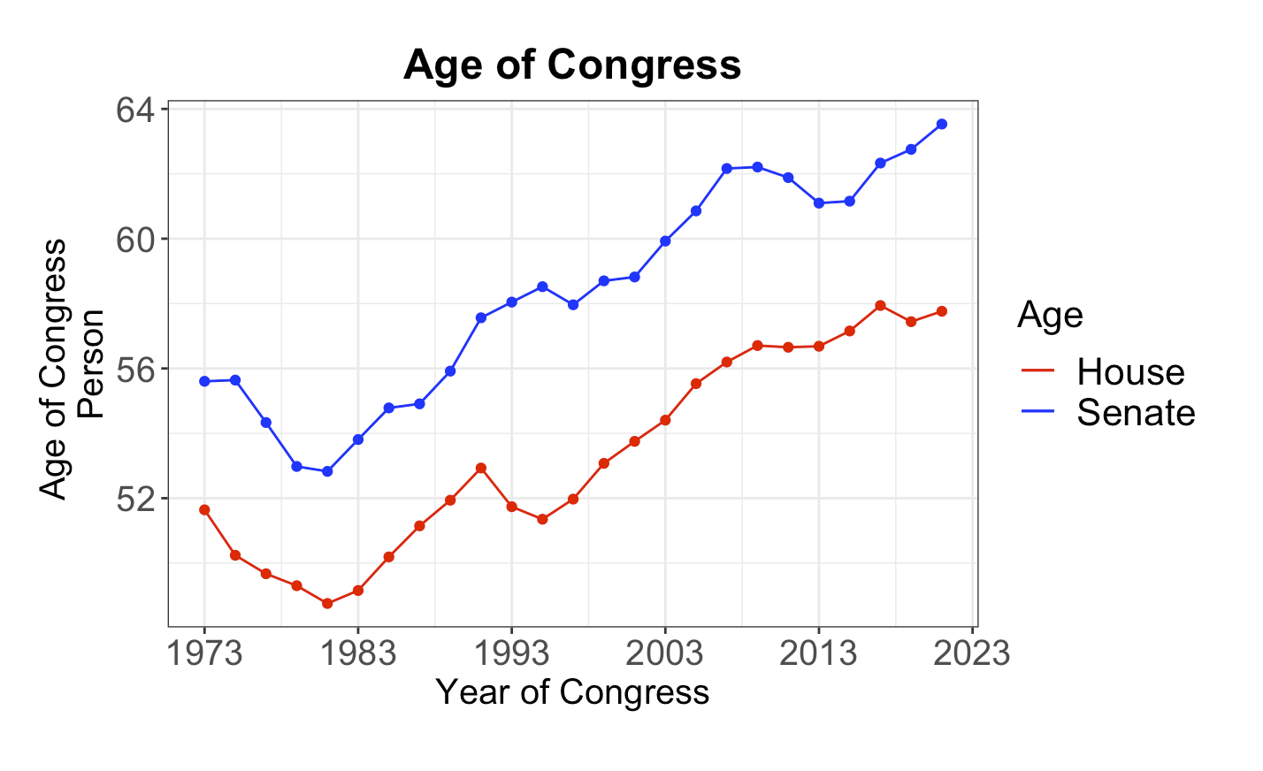
Data Visualization
We are able to confirm the age of congress throughout the years. We limit the year span so that it would reflect the same time period as the extracted data.

Slide 9
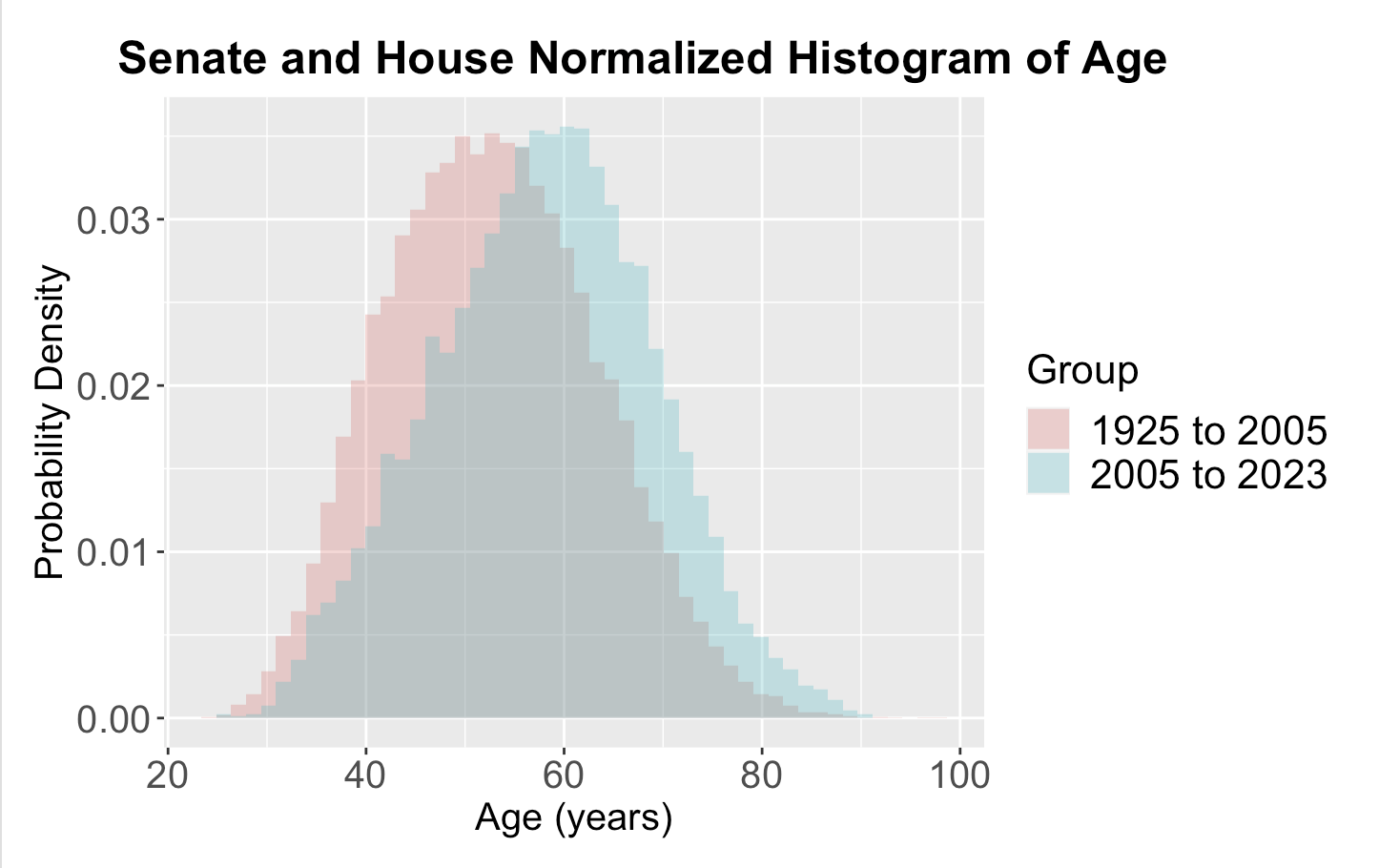
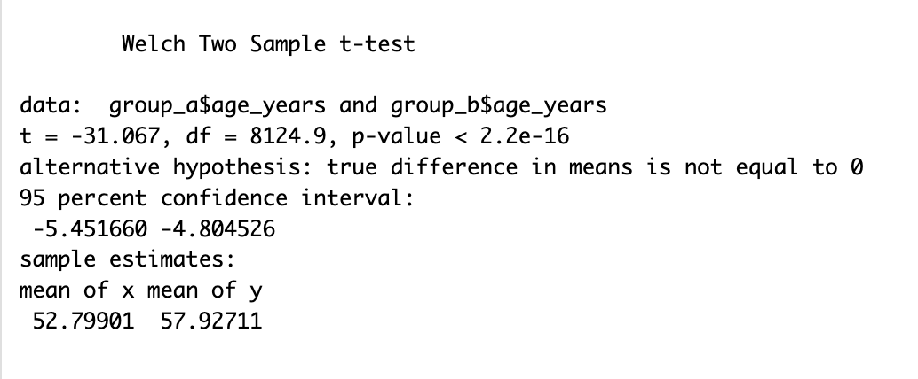
Analyzing Data
We discover that there is a significant difference between the most recent 20 years (2005-2023) and the years before (1925-2005).

Slide 10
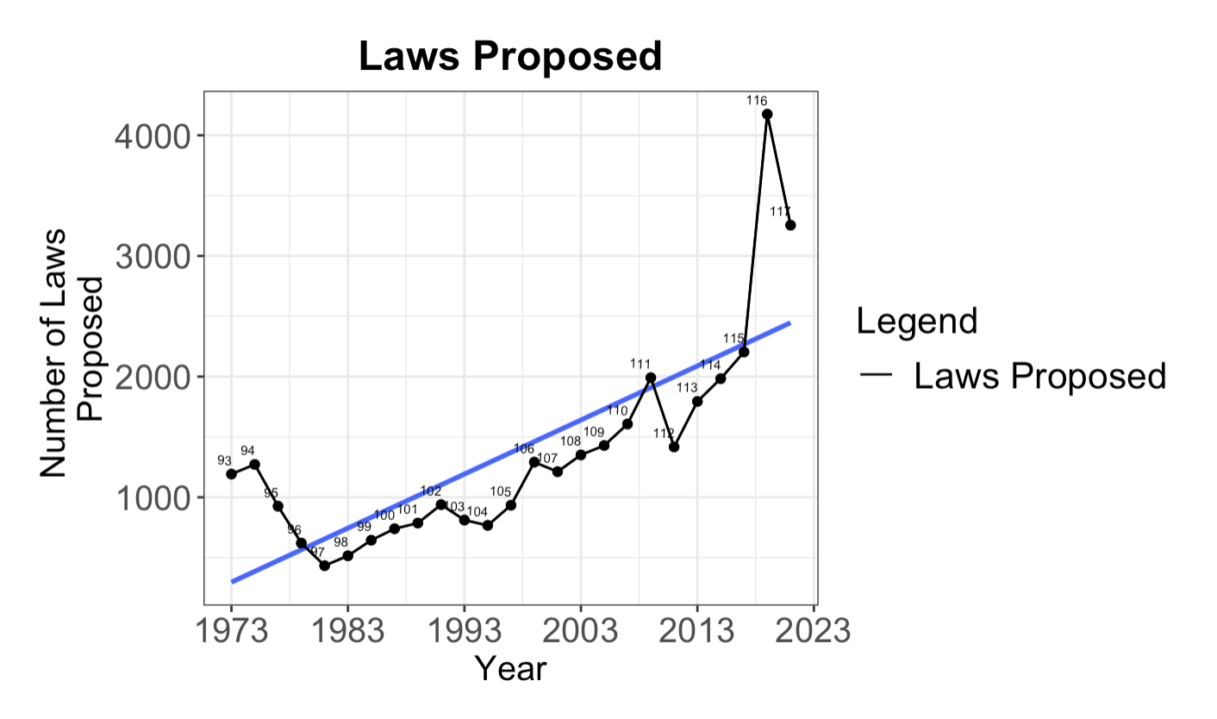
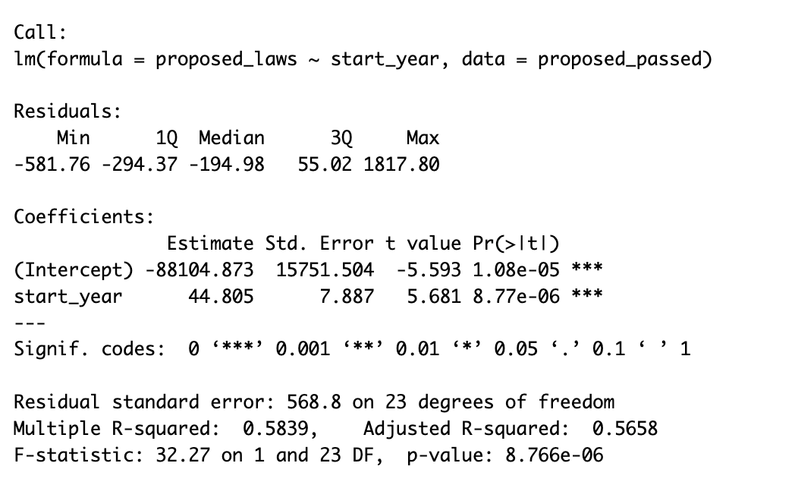
Analyzing Data
Congress 116
There is a significant increase (p=8e-06) in how many laws were proposed as the linear model suggests. In “Congress 116” nearly 4200 laws were proposed.

Slide 11
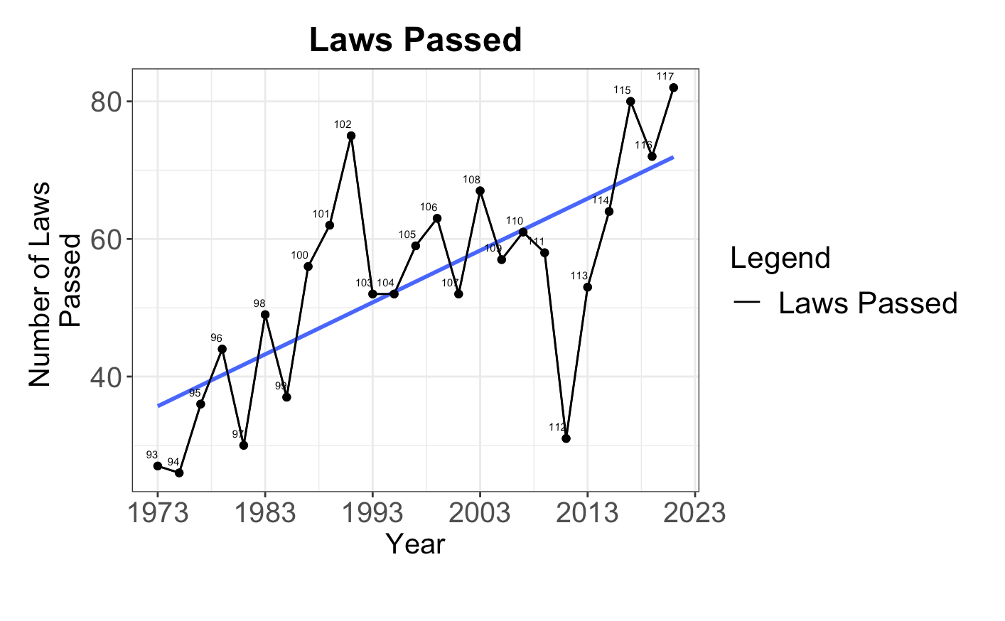
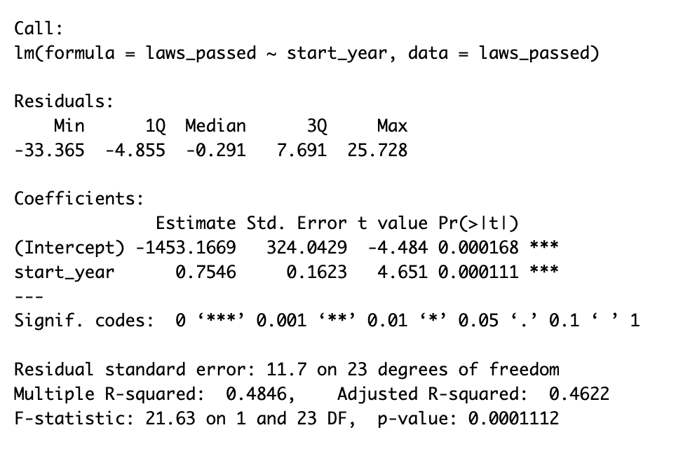
Analyzing Data
Congress 116
Still a significant increase (p=0.0001) in the overall number of laws passed, however it has slid down from “Congress 116”, 4200 laws proposed to merely around 70 laws passed!

Slide 12
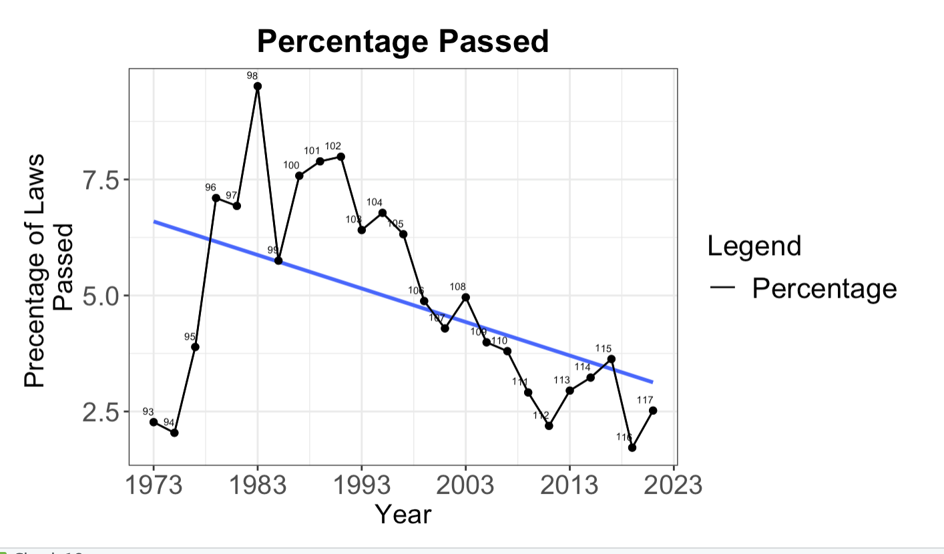
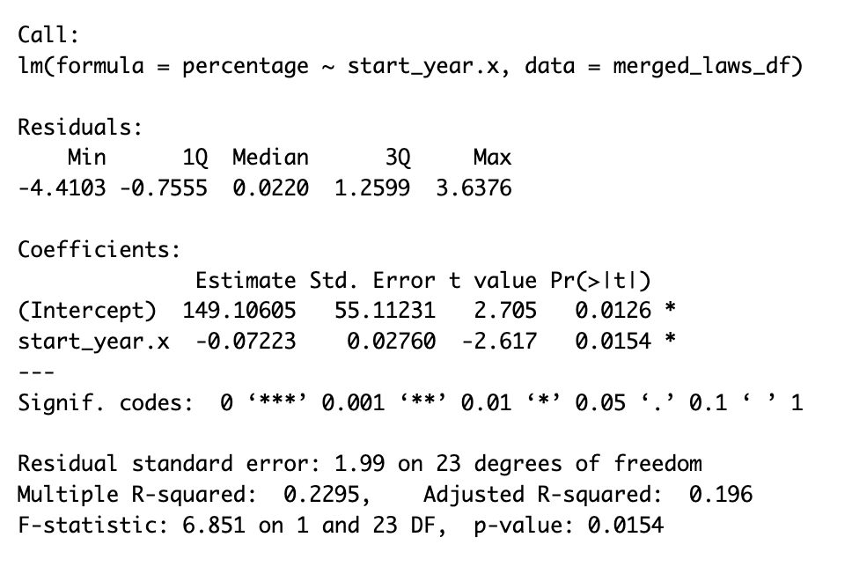
Analyzing Data
Congress 116
This graph shows us that the percentage of laws has continually gone down (p=0.01), although the number of laws being passed has risen. This suggest less working together in congress.

Slide 13
Analyzing the Data

Slide 14
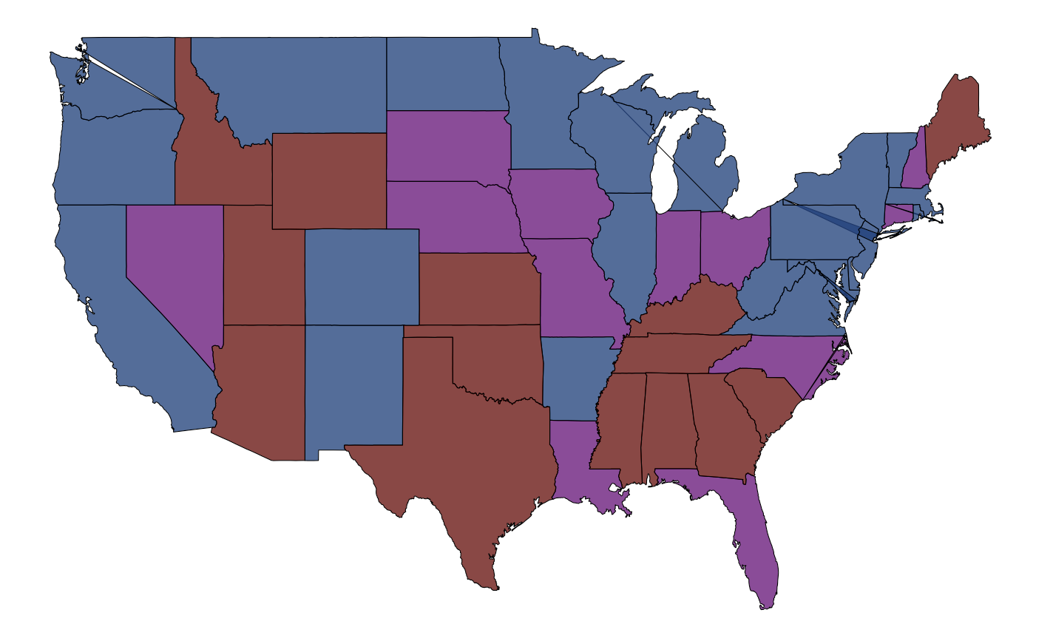
ACA voted by the Senators using ggmap
This map shows the senators that voted for the ACA act in 2010. The blue represents that both senators have voted Yea, the red suggests they have both voted Nay, and the purple represents a mixed outcome.

Slide 15
Hypotheses Answers:
- The age of congress in 2005-2023 (recent group) is shown to be positively significantly different from the past 1923-2005.
- We have found that through a linear model, that there is a increase in the number of laws being passed, however there is a decrease in the percentage of laws passed from the past.

Slide 16
Limitations
- The original web scraping plan had to be downsized to a realistic level. Originally I planned to gather the bills under the healthcare search, find out how congress people voted, and create a ggplot of how it trended over time.
- Limitation of data quality: I could not screen through individual healthcare bills, so some bills are strongly related to healthcare and others only mention it peripherally. If I were able to screen more, I would have chosen to only count the healthcare bills that are strongly related to healthcare.
- ggmap is a little polygonal visually
- I could not figure out how to put the ggplot graphs on the same axis

Slide 17
THANK YOU!
Joe Garcia

